Slide 1


BTP Neo Migration Assessment for Envases Universales de México, S.A.P.I. de C.V.
BTP Foundation , SAP
Notes:
Hello and good afternoon everyone. Thank you all for joining this meeting, my name is Shikhar and I’m a member of the SAP Migration Programme. Today I will be walking you through the neo to multi-cloud migration. This report was made from an analysis carried out on your neo accounts and should be a very useful tool to help you with your migration.

Slide 2
Agenda
1
Introduction & Management Summary
2
Migration Readiness Check – Analysis results
3
Migration Roadmap & Next Steps
4
Migration Guides – Details
Notes:
So here is the agenda for today’s presentation. The first part is the introduction and management summary. The second part will be the migration readiness check, which will be the bulk of the presentation.
It is divided up into different parts which essentially is where we will look at the results of the analysis so looking at the active subaccounts, seeing which services being used and I will give you a high-level overview of the main steps in the migration for each service you are currently using.
We will then look at a migration roadmap, which is the recommended way you should navigate this migration. This is split up into the steps you should take when preparing a migration roadmap, so planning what you will do at each stage of the migration, then there is a migration plan which is a guide I have made to cater for your migration, this is the order you could possibly carry out your migration.
Once the migration roadmap is covered, we will look the next steps so what you should do after this call and I will then open the floor up to questions but do feel free to stop me at any point to ask questions and I will do my best to answer it. If I don’t know the answer off the top of my head, I will take the question with me and I will get back to you with the answer as soon as possible.
The last section is the migration guide. I won’t be going through this in the call, but this is where you will find detailed instructions on carrying out the migration.

Slide 3


SAP BTP – Neo environment sunset
SAP Business Technology Platform, Neo environment will be sunset on December 31, 2028.
Customers and partners will need to migrate off the SAP BTP Neo environment by December 31, 2028
SAP will collaborate with customers to help minimize the impact of migration, however, customer involvement in the migration will be necessary. SAP will share best practices documentation for migration projects and execution, as well as guidance intended to help lower migration costs and commercial impact.
Notes:
As you are aware, the NEO environment will be sunset on December 31, 2028, meaning all NEO accounts will need to be migrated to the multi-cloud before this date. SAP is committed to collaborating with customers to ensure the migration has as minimal impact as possible, which is why this assessment has been made available. However, customer involvement is necessary for the migration. You are in a good position at the moment, as you’re giving yourselves plenty of time to complete the migration.
Hopefully, after this call, you will have a better understanding of how the migration process works and will be able to begin migrating soon.

Slide 4
Management Summary
This report summaries the analysis that was conducted through the Neo Sunset program for Envases Universales de México, S.A.P.I. de C.V..
There were in total 11 Neo subaccount(s) observed in 4 Global account(s). The main services observed as being used on Neo in the global account are: HTML5 Applications, Forms by Adobe, SAP Fiori Cloud, Cloud Integration.
The overall migration is considered to be high effort and a migration should be planned and executed as soon as possible to ensure migration is complete before the end of life of Neo on 31st December 2028.
Envases Universales de México, S.A.P.I. de C.V. should also ensure that the necessary multi-cloud services are commercially available on their account before starting the migration. Commercial discussions should take place with the SAP account team who can support to license the necessary services.
Envases Universales de México, S.A.P.I. de C.V. should take this roadmap to evaluate and plan their overall migration project, the Neo sunset migration program can act as a single point of contact throughout the migration journey and are available through sap.btp.migration@sap.com.
Notes:
This is the management summary, which provides a high-level overview of the services being used by your global account. During our analysis, we examined 4 global accounts. Within these global accounts, there were 11 subaccounts. The main services used in these subaccounts were HTML5 Applications, Forms by Adobe, SAP Fiori Cloud, and Cloud Integration.
After the analysis, we concluded that the migration effort can be classified as low, medium, or high. We recommend starting the migration as soon as possible to ensure it is completed by the end of 2028. However, as I mentioned earlier, you have plenty of time and are in a good position.
After this call, you will need to get in touch with your sales contact to ensure that multi-cloud services are available on your account before starting the migration. Once this is confirmed, you can begin planning your migration. This report focuses on the technical aspects of the migration, so it will provide insights into the technical requirements but not the commercial details.

Slide 5

Migration – Readiness Check
Notes:
Now we move on to the next section, which is the Migration Readiness Check.

Slide 6
Migration Readiness Check – Subaccount Overview
For this migration roadmap we analyzed the following subaccounts
Global Account | Subaccount | Services
Envases - CPEA | Envases Universales de México, S.A.P.I. de C.V. | Forms by Adobe, Cloud Integration
Envases - CPEA | S4H Cloud Platform Integration Productive | Forms by Adobe, Cloud Integration
Envases Universales de México, S.A.P.I. de C.V. | CPI Productive - l700124 | HTML5 Applications, Cloud Integration
Envases Universales de México, S.A.P.I. de C.V. | CPI Test - e700034 | HTML5 Applications, SAP Fiori Cloud, Cloud Integration
Envases Universales de México, S.A.P.I. de C.V. | Glud & Marstrand A/S | -
Notes:
This table provides an overview of the global accounts, subaccounts, and the services being used.
Next, we’ll examine the subaccounts and the services used by each account. As mentioned before, we analysed 11 neo subaccounts. The middle column shows the technical name along with a link to each subaccount, followed by a list of services being used.

Slide 7
Migration Readiness Check – Subaccount Overview
For this migration roadmap we analyzed the following subaccounts
Global Account | Subaccount | Services
Envases Universales de México, S.A.P.I. de C.V. | Cloud Platform Integration Productive - l5676 | Cloud Integration
Envases Universales de México, S.A.P.I. de C.V. | Cloud Platform Integration Test - e5661 | Cloud Integration
Envases Universales de México, S.A.P.I. de C.V. | Envases Universales de México, S.A.P.I. de C.V. | -
Envases Universales de México, S.A.P.I. de C.V. | Cloud Platform Integration Productive - l100435 | Cloud Integration
Envases Universales de México, S.A.P.I. de C.V. | Cloud Platform Integration Test - e100212 | Cloud Integration
Notes:
The services include HTML5 Applications, Forms by Adobe, SAP Fiori Cloud, and Cloud Integration.

Slide 8
Migration Readiness Check – Subaccount Overview
For this migration roadmap we analyzed the following subaccounts
Global Account | Subaccount | Services
Envases Universales de México, S.A.P.I. de C.V. | Envases Universales de México, S.A.P.I. de C.V. | -

Slide 9
Migration Readiness Check – Other Solutions Overview
Service | Tenants
SAP Cloud Integration for data services | DSEU3873 (ID 740793230), L5676 (ID 740491613)
SAP Enable Now Cloud | h5ecdab20 (ID 741272112)
Notes:
SAP Cloud Integration for data services and SAP Enable Now Cloud are the two other services we observed in your subaccounts and before migration these need to be kept in mind.
Now the next section will show the corresponding services in the multi-cloud.

Slide 10
Migration Readiness Check – Analysis
Below is a mapping of existing Neo services to the recommended multi-cloud replacement
Neo Service | Multi-Cloud Service | Analysis | Migration Guide
HTML5 Applications | SAP BTP, Cloud Foundry Runtime (LCM) | Link | Link
Forms by Adobe | Forms Service by Adobe | Link | Link
Connectivity | Connectivity Service | Link | Link
SAP Fiori Cloud | N/A | Link | Link
SAP Cloud Integration for data services | SAP Cloud Integration for data services | Link | Link (planned for Q3 2024)
Cloud Integration | Integration Suite | Link | Link
SAP Enable Now Cloud | SAP Enable Now Cloud
Notes:
Here is a list of the services you are currently using in NEO and the corresponding services you will need in the multi-cloud environment. The links provided will take you to the analysis section of the report, while the other links will direct you to the migration guide, which is also included in the end of this report.
As we go through each service and its mapping, you should have a clearer understanding after reviewing the documentation. Additionally, we recommend using the Transport Management Service. This service manages application and content transport within a landscape on BTP, making it a valuable tool for transporting between different subaccounts within the same environment, such as moving from a development account to production. We recommend this service as it can greatly assist with the migration process.

Slide 11
Migration Readiness Check – Analysis SAPUI5
Back to Analysis Slide
The few elements below require your attention
Criticality – MEDIUM Complexity – HIGH
SAPUI5 Applications:
There are/is 6 SAPUI5 application(s) running on 2 Neo subaccount(s).
Recommendations
The applications need to be adapted to support Multi-Cloud environment
Enable SAP Fiori tools extensions to use Fiori tools which can be used to migrate the HTML5 applications.
SAPUI5 and Fiori Launchpad applications can be deployed on Multi-Cloud using one of the following ways:
Serving the Application with AppRouter
Serving Application with Work Zone and html5-apps-repo
SAP Neo to MultiCloud Migration
Developing SAPUI5 in SAP Multicloud
SAP Application Router
General Guide is available here (In this guide Business Application Studio is used as IDE to adapt the apps)
Notes:
Here are the SAPUI5 applications running on your subaccount. There are/is 6 SAPUI5 application(s) running on 2 Neo subaccount(s). We estimate this will be of MEDIUM criticality and HIGH complexity. The application needs to be adapted to support the Multi-Cloud environment.
First step is to get the source files from the NEO HTML5 application. Usually these can be downloaded from the GIT repo on the sub-account.
Then you can use the Business Application Studio (BAS) to adapt the apps to the Cloud Foundry runtime.
Loading them up in a Fiori dev space in Business application studio will auto trigger the migration/adaption.
Once adapted the NEO_app.json file can be removed.
You will then need to add deployment descriptor to it which will produce the MTA.yml which is Multi-target Application.YML. Then you will build this file and deploy it to the Cloud Foundry space of your choice.
It's important before starting the migration process to check the manifest file and the neo-app.json file for any destinations that are needed.
Its good to import these to the sub-account you are deploying before you start.
Once deployed you can then serve it either from a managed app router or a standalone app router. Usually we have seen customers using the managed app router from SAP Build WorkZone standard edition.
Once a subscription to this service is made it will appear in the sub-account under HTML5 and serve the Fiori and HTML5 apps from there.

Slide 12
Migration Readiness Check – Analysis SAP Forms by Adobe
Back to Analysis Slide
The few elements below require your attention
Criticality – MEDIUM Complexity – MEDIUM
SAP Forms by Adobe
Recommendations
If you already have specific configuration settings or files on your NetWeaver ADS or Neo subaccount, you can migrate them to the SAP Forms service.
All end points will be the same but there is a changes regarding the binding of the service and authentication implementation.
Migration from On-Premise ADS or Neo Subaccount
Further details of the Multi-cloud service can be found here: SAP Forms Service by Adobe
Notes:
Forms by Adobe was enabled in your sub-account. We estimate this will be of MEDIUM criticality and MEDIUM complexity.
For migrating this service.
The first step would be to enabled SAP Forms service in your multi-cloud sub-account.
You can do that by navigating into Service and then Service marketplace and selecting Forms Service by Adobe
If you already have specific configuration settings or files on your NetWeaver ADS or Neo subaccount, you can migrate them to the SAP Forms service in Cloud Foundry.
You copy your configuration settings or files from your existing NetWeaver ADS installation or Neo subaccount to the SAP Forms service.
There are just a few things to consider when you are planning for migration,
The interface to ADS remains the same, you can still use your print programs and custom form templates that are stored in the ABAP system. You only need to perform configuration changes and If you already have specific configuration settings or files on your NetWeaver ADS or Neo subaccount, you can migrate them to the SAP Forms service.
Finally,
All endpoints of the SAP Forms service REST API in SAP BTP, Cloud Foundry environment, are the same in the Neo-provided service. You do not need to change the input and output handling of your applications. However, binding the service to your Cloud Foundry application and implementing authentication is different.
For more information on this, we do have a detailed guide on how to get started and on the migration steps of the services in the link here so do refer it to get ramped up on the migration process of this service.

Slide 13
Migration Readiness Check – Analysis Connectivity
Back to Analysis Slide
The few elements below require your attention
Connectivity:
There are/is 6 configured tunnel(s): 6 with agent version 2.17.0.
Destinations
Recommendations
Add all the multi-cloud subaccounts as a subaccount into the SCC.
Use the copy subaccount feature to copy an existing subaccount configuration in the Cloud Connector to another subaccount in the SCC.
Configure Principal Propagation with SCC for multi-cloud subaccounts.
Once SCC is configured with multi-cloud environment, you’ll need to manually export and import the destinations between subaccounts.
If you have many destinations to export and import you can check the sample automation application that can achieve this at https://github.com/SAP-samples/btp-destination-service-samples
Notes:
For Connectivity of your cloud connectors and destinations, and it is a relatively straight forward migration. You currently have 6 configured tunnel(s): 6 with agent version 2.17.0. So starting with the cloud connector what you will do is first go to the Connector Tab on the cloud connector, you will then add your new multi-cloud subaccount. Then you will then hop over to your subaccount and go to the multi-cloud account you just added and press the connect button to establish your connection. Finally you will navigate to the cloud to on-premise button and under Access Control you can select import mappings and import your neo sub account. Then migrating the destinations is similar again (if any). You will navigate to the destination section of your neo subaccount, choose the destination you want to migrate and download a file. Then in your multi-cloud account it is just a case of going to destinations, pressing import destination and uploading your file.

Slide 14
Migration Readiness Check – Analysis SAP Fiori Cloud
Back to Analysis Slide
The few elements below require your attention
Criticality – MEDIUM Complexity – MEDIUM
SAP Fiori Cloud
Recommendations​
In February 2019 SAP decided not to release additional Fiori Cloud applications and content packages for SAP S/4HANA and SAP Business Suite. This is aligned with the revised strategy for SAP Front End Server (FES) architecture, recommending customers to install and run an embedded (on-premise) Frontend Server architecture for SAP S/4HANA and central hub (on-premise) for Business suite.
Consider the implementation of On Premise Front End server - For more information, see SAP Fiori Deployment Options and System Landscape Recommendations.
In summary, the recommendation for the SAP Fiori front-end server (FES) deployment is the following:
For SAP S/4HANA, the embedded SAP FES deployment is recommended.
For SAP Business Suite scenarios, SAP FES as a central hub is still the recommended deployment.
Federate/Integrate the On-premise Fiori apps to Central Launchpad on CF
SAP offers advanced UX integration capabilities on SAP Cloud Platform (Cloud Foundry) to help organizations establishing a central entry point and providing users easy access to SAP, custom-built and third-party applications, services and tasks – either from on-premise or cloud.
Notes:
SAP Revised its’ strategy for these Fiori apps and no longer want customers running them from the cloud platform. Instead the revised strategy is that front end server should be used.
So based on what you are using your Fiori Applications along with S/4 HANA or the business suite, there are two deployment options
For SAP S/4HANA, the embedded SAP FES deployment is recommended.
For SAP Business Suite scenarios, SAP FES as a central hub is still the recommended deployment
Once that setup is done you can then use SAP Build Work zone to implement a common, central point of access for the applications.
The Slide contains a link for a detailed document that goes through this process and explains on the different deployment options for the Fiori applications. If there are any questions in the topic, do let me know I will get them check with an expert and get back to you on them.

Slide 15
Back to Analysis Slide
Migration Readiness Check – Analysis SAP Cloud Integration for data services (CPI-DS)
The elements below require your attention:
Criticality - MEDIUM Complexity - MEDIUM
SAP Cloud Integration for data services (CPI-DS) in Neo
Recommendations
SAP Cloud Integration for Data Services (CI-DS) is designed for time series and master data integration with SAP Integrated Business Planning (IBP). It is included with the SAP IBP application license and will continue to be supported.
The server component of SAP CI-DS currently operates on the NEO environment, with no plans to discontinue its use for SAP Integrated Business Planning (IBP). CI-DS will transition to SAP BTP Multi-cloud, aligning with the SAP BTP roadmap and leveraging popular hyperscalers.
Though no public roadmap is available, SAP will assist customers with the migration, aiming to minimize disruption.
Timelines and detailed plans will be announced in Q3 2024, with updates available through webcasts at the IBP Engagement Hub / blog .
Notes:
The server component of SAP Cloud Integration for data services (SAP CI-DS) currently operates on the NEO environment, with no plans to discontinue its use for SAP Integrated Business Planning (IBP) as (CI-DS) is designed for time series and master data integration with SAP Integrated Business Planning (IBP).
CI-DS will transition to SAP BTP Multi-cloud, aligning with the SAP BTP roadmap and leveraging popular hyperscalers.
Though no public roadmap is available, SAP will assist customers with the migration, aiming to minimize disruption.
Updates on this will be announced in Q3 2024 and there are a few links here through which the updates will be available.

Slide 16
Back to Analysis Slide
Migration Readiness Check – Analysis Cloud Integration
The elements below require your attention:
Criticality - HIGH Complexity - HIGH
Global Account | Subaccount | Tenant | Artifacts
Envases Universales de México, S.A.P.I. de C.V. (ID *5704) | CPI Productive - l700124 | l700124 (ID 740793319) | 45 Integration Flow, 1 Value Mapping, 1 Java Keystore, 13 Security Materials
Envases Universales de México, S.A.P.I. de C.V. (ID *5704) | CPI Test - e700034 | e700034 (ID 740793320) | 40 Integration Flow, 1 Value Mapping, 1 Java Keystore, 24 Security Materials
Envases Universales de México, S.A.P.I. de C.V. (ID *7239) | Cloud Platform Integration Productive - l5676 | l5676 (ID 740484790) | 84 Integration Flow, 1 Value Mapping, 1 Certificate-to-User Mappings, 1 Java Keystore, 5 Security Materials
Envases Universales de México, S.A.P.I. de C.V. (ID *7239) | Cloud Platform Integration Test - e5661 | e5661 (ID 740484792) | 91 Integration Flow, 1 Value Mapping, 1 Certificate-to-User Mappings, 1 Java Keystore, 7 Security Materials
Envases Universales de México, S.A.P.I. de C.V. (ID *8074) | Cloud Platform Integration Productive - l100435 | l100435 (ID 740685791) | 26 Integration Flow, 3 Value Mapping, 1 Java Keystore, 39 Security Materials, 2 PGP Keys
Notes:
Next up is your Cloud integrations. We can see these were active in the 8 subaccounts.
We all see a list of the usage in all the tenant. So we will take CPI Productive as an example, (45 Integration Flow, 1 Value Mapping, 1 Java Keystore, 13 Security Materials) so on so forth.

Slide 17
Migration Readiness Check – Analysis Cloud Integration
The elements below require your attention:
Criticality - HIGH Complexity - HIGH
Global Account | Subaccount | Tenant | Artifacts
Envases Universales de México, S.A.P.I. de C.V. (ID *8074) | Cloud Platform Integration Test - e100212 | e100212 (ID 740685792) | 67 Integration Flow, 2 Value Mapping, 1 Java Keystore, 69 Security Materials, 2 PGP Keys
Envases - CPEA (ID *2384) | Envases Universales de México, S.A.P.I. de C.V. | e800086 (ID 741383839) | 49 Integration Flow, 3 Value Mapping, 1 Certificate-to-User Mappings, 1 Java Keystore, 62 Security Materials, 1 JDBC Driver, 2 PGP Keys, 1 Subsystem
Envases - CPEA (ID *2384) | S4H Cloud Platform Integration Productive | l800249 (ID 741845728) | 47 Integration Flow, 1 Value Mapping, 1 Java Keystore, 47 Security Materials, 2 PGP Keys, 1 Subsystem

Slide 18
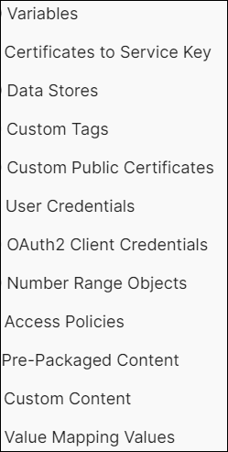
Migration Readiness Check – Analysis Cloud Integration
Recommendations
In the multi-cloud environment Integration Suite service needs to be enabled. The known SAP CI limitations on BTP multi-cloud are documented under the note: 2752867. Its highly recommended to regularly check this note as SAP CI development is constantly working to address this known limitations.
Versioned Iflows, upto date standard pre-packaged contents, value mapping artefacts can be migrated using the SAP CI migration pack. Ensure artifacts runtime version should match the version of the design time. Additionally execute the readiness check through SAP CI migration tool, More info : 2937549
Security materials - Migration pack can be used, but password should be updated manually after the migration. Migration of PGP Keys, known host, Keypairs - need to be manual work
Consumers of iflows need adjustment post migration.
Side by side migration can be performed without major disruption.
Additional info Migrate from Neo to Cloud Foundry – SAP Cloud Integration | SAP Blogs
Note: Post migration, on the target tenant only the latest version of the package and artefacts will be available, i.e. version revision history won’t be migrated to the target tenant.
Migration Tool capability
Notes:
So on to our recommendations, the first step will be to enable the Integration Suite service on the Cloud Foundry environment.
There are a few small Limitations of CPI on Multi-Cloud.
So when it comes to migration your CPIs, first what you will do is enable the Integration Suite service on the multi-cloud. Then the majority of the migration can be done using the CPI migration tool. This tool can migrate your Iflows, value mappings, security materials, SF entity and Oauth credentials, once they are all versioned correctly. We recommend you update the passwords for these artifacts after the migration. There are a few things which will need to be migrated manually for security reasons, these being your PGP keys, known host and Keypairs. So to do the migration first, what you will do is download the migration pack. Then you will create an Oauth client in the Neo environment, which you will assign the necessary authorisations. After that you will set up inbound authentication with Oauth Client Credentials on the tenant in Multi-cloud. Then you will need to have postman installed, where you will have to fill the credential file in postman with the required information before the migration. Finally, to perform the migration, you will run a number of Postman requests. To execute these requests, you can use a set of Postman collections predefined by SAP, which you can access via the SAP Note here.
You won’t be able to get the version revision history once migrated, and the version history of an artifact will not be available. A general rule of thumb is that it will take half a day to migrate a single IFlows. This will depend on the experience of the person doing the migration but on average you will be looking around half a day per Iflow.
For more information please do refer the blog post attached in the slide

Slide 19
Migration – Roadmap
Notes:
So now I will talk about the Migration Roadmap

Slide 20
Building Migration Roadmap
Prepare people, data & environments
Set up your multi-cloud environment
Enable and configure the required services
Recreate(reconfigure) or Export & Import the objects either manually or using the migration packs
Existing Setup
Identify the services activated and consumed in Neo
Evaluate the applications and the use to draw migration road map
Adjust consumer & E2E testing
Adjust your backends or consumer systems to multi-cloud subaccount service/application
Evaluate
Plan
Prep
Test
Migrate
Live
Migration Strategy and plan
Identify the tools available from migration pack
Plan for the manual effort required
Define the migration path and migration scripts
Side-by-Side Migration Strategy
Test Locally
Pilot or test drive the application/ services in multi-cloud
Go-Live support & Hyper care
Launch and monitor your application/services from multi-cloud environment
De-commission older tenants post cool-off period.
Notes:
There are 6 steps in building the roadmap 1) Evaluate
2) Plan
3) Prep
4) Test
5) Migrate
6) Live
So this is a general diagram on building a migration map that outlines the different phases of the migration. We try to get step 1 out of the way with this call so that is your evaluation. Then it will be up to you to begin the migration. So the next stage is to plan your migration by identifying the tools available from the migration pack, planning the manual effort required, defining the migration path and scripts and then planning your side-by-side migration strategy. Once you have completed the first two stages you will begin to prepare. You will do this by setting up and configuring the multi-cloud environment and recreating or importing/exporting the objects either manually or using migration packs. Next phase then is to test, so making sure everything is working correctly. [ A very useful tool for testing is postman, which lets you tests locally (Include with CPI)]. Then once you have everything tested you can migrate your systems to your multi-cloud subaccount by adjusting your backends or consumer systems to multi-cloud subaccount service or application. After that you are ready to go-live, we recommend keeping the neo service for a week or two in case you need to fall back to it. Once everything is stable and working you can go ahead and delete the neo accounts to avoid getting charged for them.

Slide 21
Migration Plan
Activate Subscription
Copy the Destination
Configure multi-cloud subaccounts
Create subaccount and spaces
Configure SAP Cloud Connector
Connect new multi-cloud subaccounts
Copy subaccounts configuration
Transport to Qual/Prod subaccounts
Migrate CPI to Integration Suite
Configure TMS on multi-cloud (Optional)
Migrate HTML5 Applications to Cloud Foundry Runtime
Activate customIDP
Migrate Cloud Portal to SAP Build Work zone
Migration SAP Fiori Cloud to HANA Cloud
You can plan your migration based on different business scenarios.
For example, you can set up the multi-cloud environment, migrate your HTML5s and then test instead of doing a full landscape migration and then testing.
Notes:
Next, we have the personalized migration plan that has been prepared for you.
This is the approach we recommend for your migration. First, you'll configure your multi-cloud subaccounts, followed by the configuration of your SAP Cloud Connectors.
Once those are completed, you can migrate your CPI to the Integration Suite. After that, as we discussed earlier, you should migrate SAP Fiori Cloud to HANA Cloud. Next, you'll migrate your HTML5 Applications to Cloud Foundry Runtime, followed by the migration of your portal service to SAP Build Work Zone. The final steps involve configuring your Transport Management Service and transporting to the quality and production subaccounts.
This is our recommended plan, but you can tailor your migration approach based on your specific business requirements. Feel free to plan your migration according to different business scenarios that best suit your needs.

Slide 22
Next Steps
Notes:
Now we move on to Next steps which is the last section of today’s presentation.

Slide 23
Migration Next Steps
Create a project plan based on this roadmap incorporating all the services to be migrated
Identify resources who will complete the execution of the migration and ensure adequate skills and knowledge on migration processes
Ensure commercial aspects of migration are considered and in place before starting to migrate
Plan for comprehensive testing and a go-live/cutover window to start using the multi-cloud services and applications productively
Execute the migration according to the project plan
Delete the Neo subaccounts which are no longer in use
Notes:
As I mentioned before, you can either create a project plan based on the roadmap we have provided or develop your own. After this call, your next step will be to create a detailed project plan outlining when each service will be migrated.
You'll need to identify who will handle the migration—whether it will be someone internal or if you decide to outsource it. Next, you'll need to ensure that all commercial aspects are in place before beginning the migration.
Following that, you'll need to plan for comprehensive testing and then a go-live with the multi-cloud services. As mentioned earlier, we recommend keeping the NEO accounts active for a week or two after the migration, just in case any issues arise. After that period, you can safely delete the NEO accounts.
The most important thing to remember here is that you must delete any NEO subaccounts that are no longer in use.

Slide 24

Migration Execution Support
The execution of the migration to multi-cloud is the responsibility of the customer but SAP offers support throughout this process
Migration assessment team can act as ’single point of contact’ for SAP BTP Migration related queries
We can facilitate checkpoint calls while you execute the migration
We can provide direct access to SAP development teams in case of any issues with migration tools
SAP Support
For any support requests please reach out to our migration mailbox at sap.btp.migration@sap.com
Notes:
Finally, while the responsibility for carrying out the migration rests with the customer, SAP will offer support throughout the process.
Our migration team will serve as your single point of contact. If you have any questions or need assistance, please feel free to email me or use the migration mailbox listed here, which is monitored daily. Should you require additional calls during the migration, we are happy to arrange those. For more complex issues, we can also coordinate with our development teams to provide further support.

Slide 25

Q & A
Notes:
So I hope everything was clear up until this point, I’ll pass the floor over to you if you have any questions. If you don’t have any now, again feel free to email me at any stage.
At the end of the presentation, you will find a detailed migration guide. As mentioned earlier, this call provides only an overview of the migration process, so we won’t be covering the guide in depth today. However, the guide is an excellent resource, offering comprehensive information on how to carry out the migration. I highly recommend reviewing the migration guide on your own, as it will be a valuable tool throughout the process.

Slide 26
Thank you.
BTP Migration Factory
sap.btp.migration@sap.com
Shikhar Dang
shikhar.dang@sap.com
Notes:
Thank you for your attention throughout this presentation. My contact information is listed here, along with the email address for our team’s mailbox. If you have any questions or need further clarification, please don’t hesitate to reach out. I will be forwarding this report to you shortly after the call so that you have all the details at your fingertips. Once again, thank you for your time and engagement.

Slide 27
Migration Guides

Slide 28
Configure Multi-Cloud

Slide 29
Platform & Application Users, Roles and Authorizations
Replicating the Platform & BTP application users, roles and authorizations from NEO to the Multi-cloud environment is a manual process. There is no automated tool for this migration. Please see the following help pages for details on how to configure this on the multi-cloud environment.
Building Roles and Role Collections for Applications
SAP Authorization and Trust Management Service in the Cloud Foundry Environment
Security Administration: Managing Authentication and Authorization
If a custom IDP is used for the BTP-Neo landscape, to replicate it to the BTP multi-cloud all the configurations need to be redone.

Slide 30
Create Subaccount and Multi-Cloud Space
Log into SAP BTP then your select your region & global account.
Choose New Subaccount, pick display & domain name then save.
Select the newly created subaccount, choose Enable Cloud Foundry, provide a Cloud Foundry organization name, and then choose Create.
Choose Spaces in the navigation bar and select New Space. Enter space name, assign roles and save your changes.
For more information on Role Collections, please see this guide

Slide 31
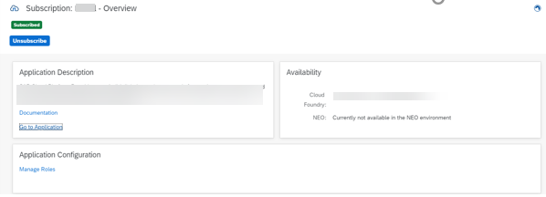
Activate Subscriptions
Before activating subscriptions, the Service Plan needs to assigned in the Entitlements tab in your subaccount home page.
Once your plan has been assigned, select the Subscriptions tab and search for your chosen service.
Select your chosen service and click Subscribe. Once subscribed you then select Go to Application to start using this.

Slide 32
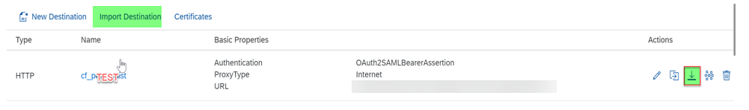
Copy destinations from NEO to Cloud Foundry – Export & Import
NEO
Navigate to your NEO subaccount homepage and select the Destinations tab.
Choose the destination you want imported & click the import button
This will generate a file saved to your downloads, this will be the file we will import on the Cloud Foundry side
Cloud Foundry
Navigate to your Cloud Foundry subaccount homepage and select the Destinations tab.
Choose Import Destination
Upload the file generated from the export procedure
If you have many destinations to export and import you can check the sample automation application that can achieve this at https://github.com/SAP-samples/btp-destination-service-samples

Slide 33
HTML5 Applications
Back to Analysis Slide

Slide 34
HTML5 Application Migration Steps
The HTML5 application migration process is comprised of various steps, from migrating the application code itself till migration of associated authorizations roles and destinations.
The e2e migration process is described here.
Specific steps on migrating Fiori applications can be found here.
A blog illustrating the process can be found here.

Slide 35
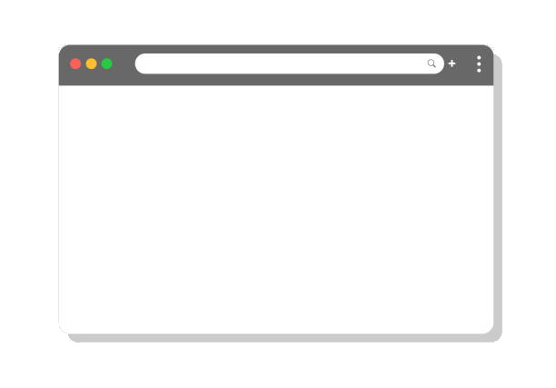



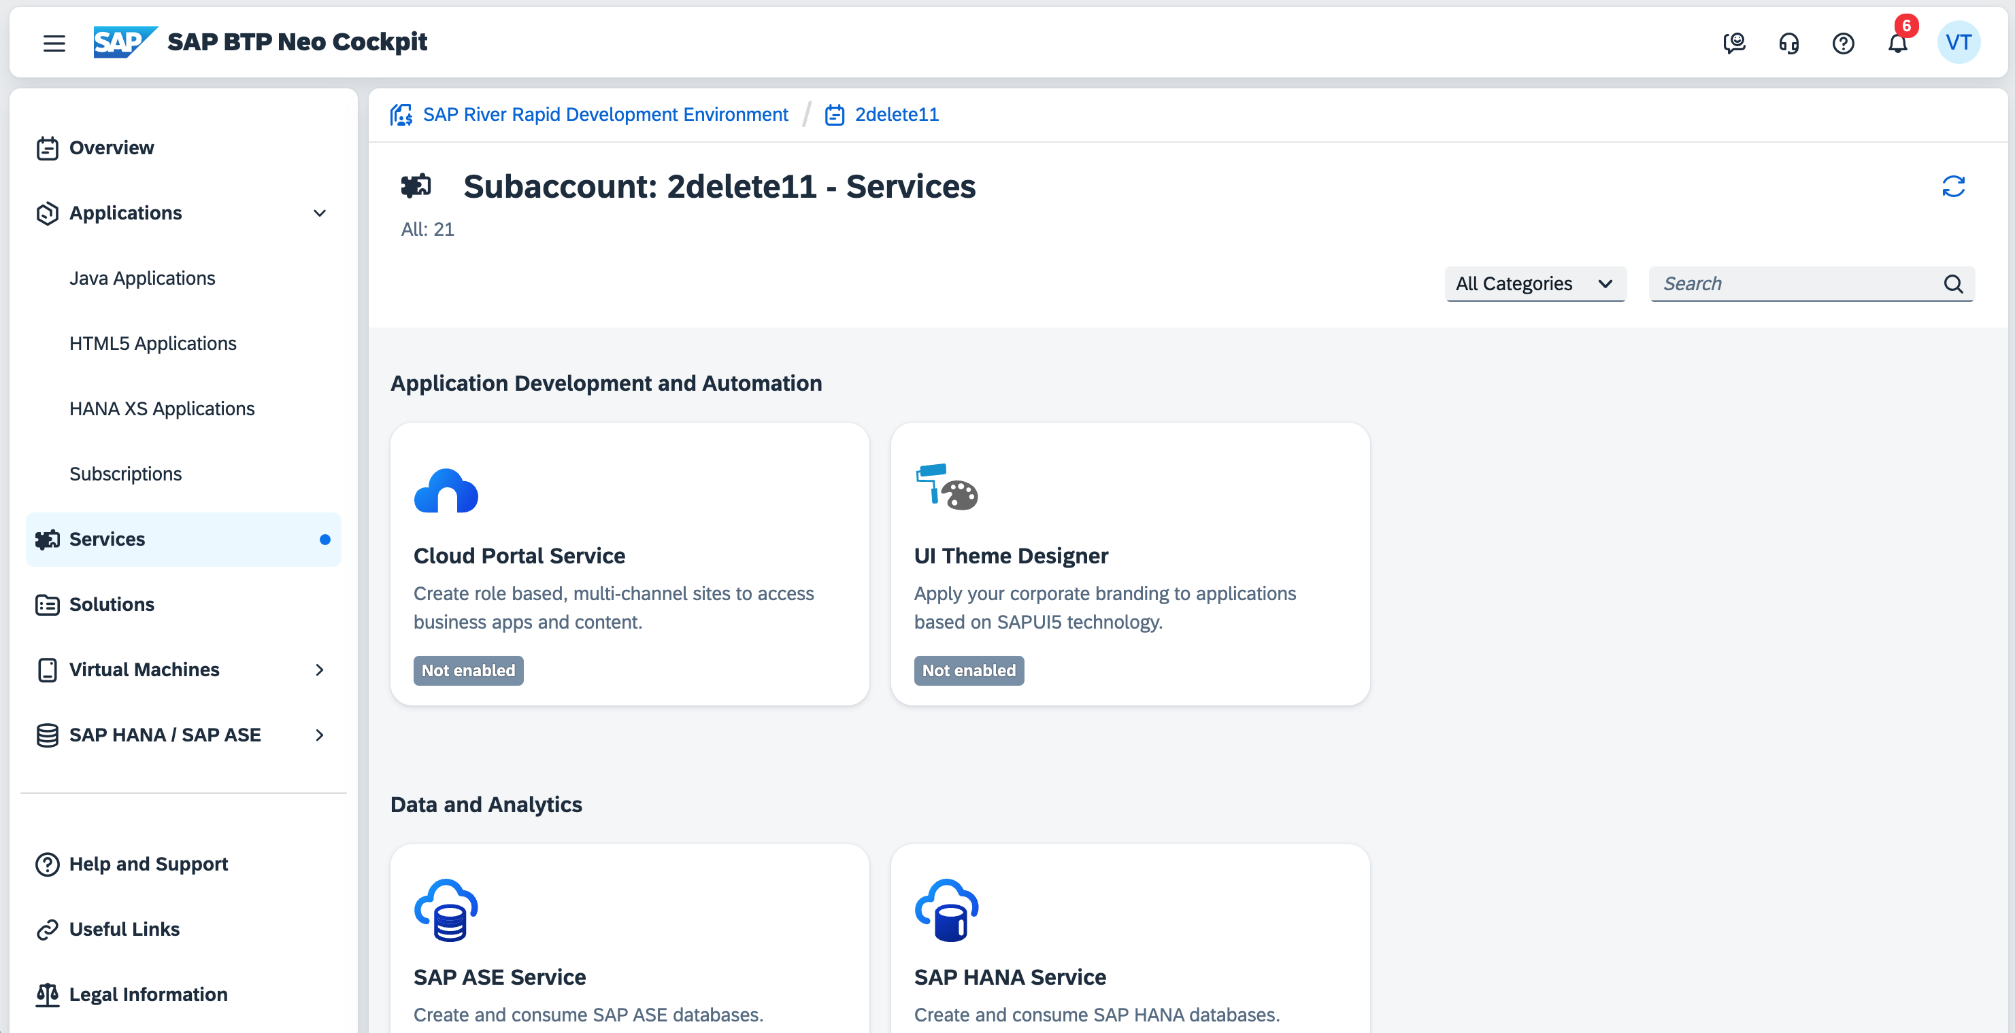
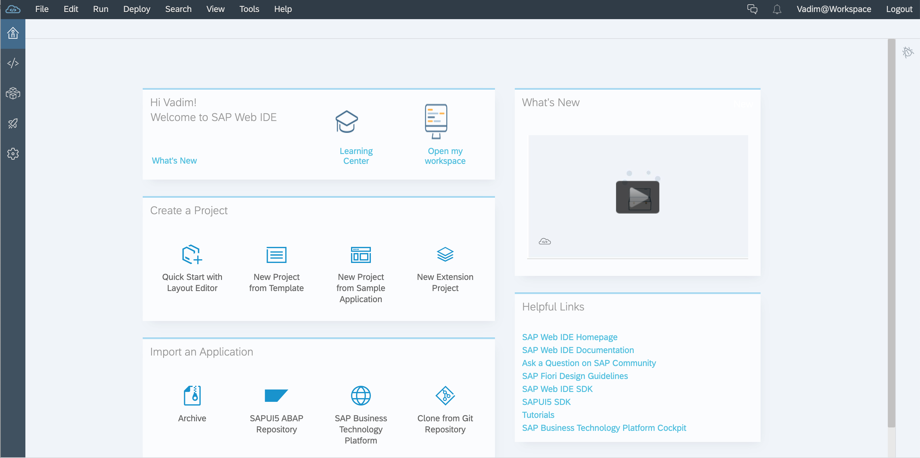
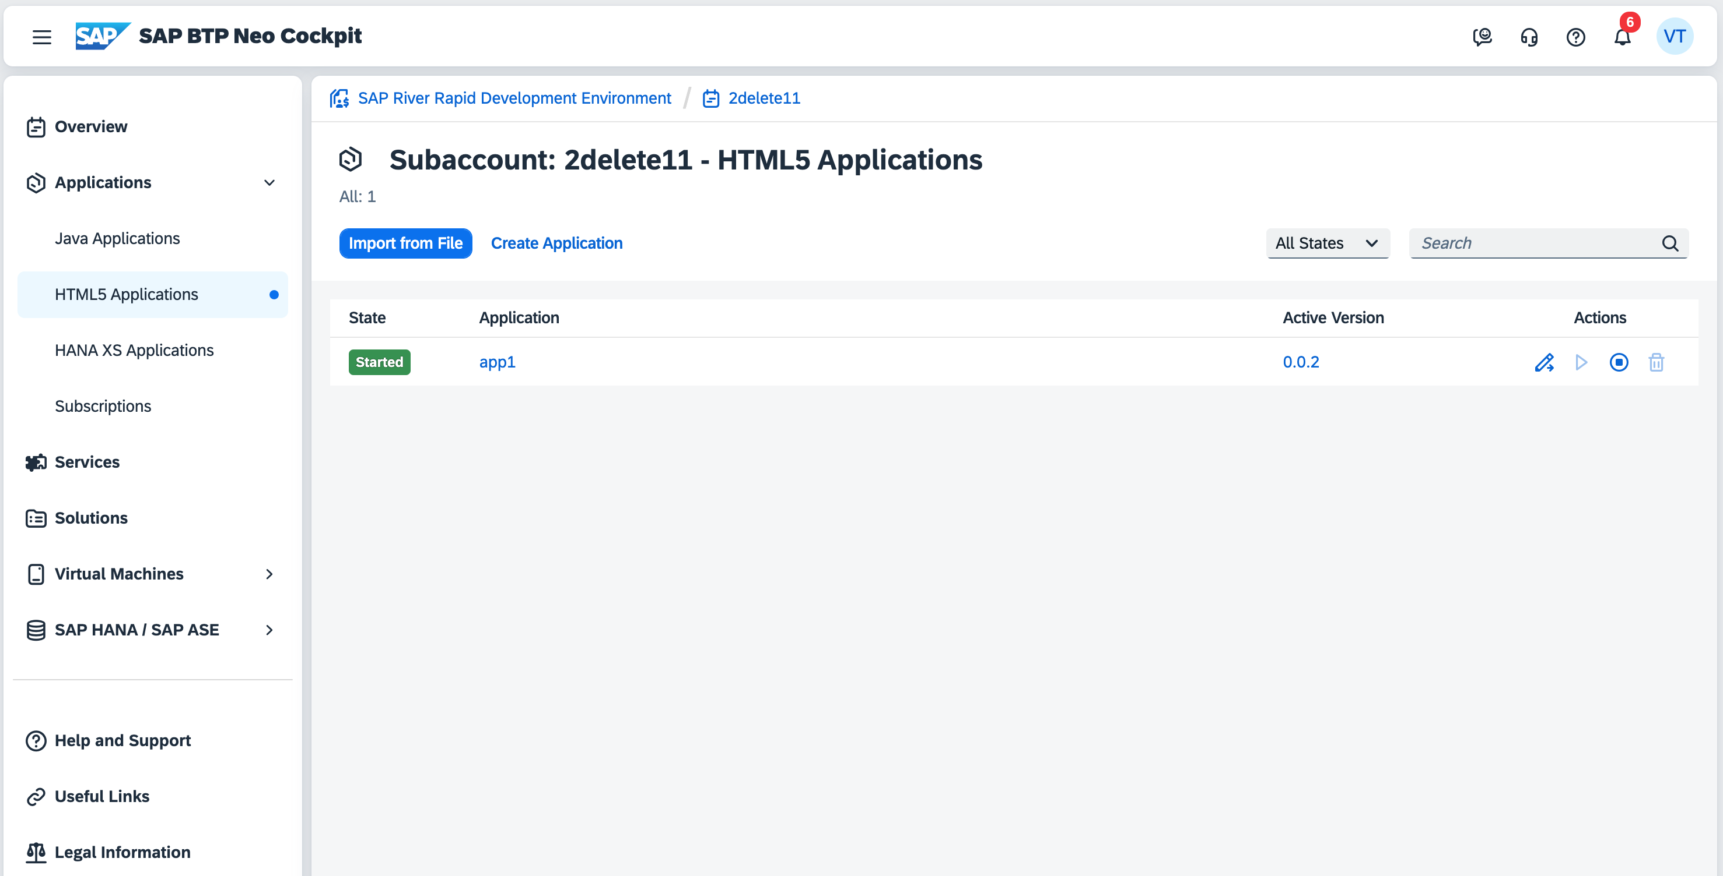
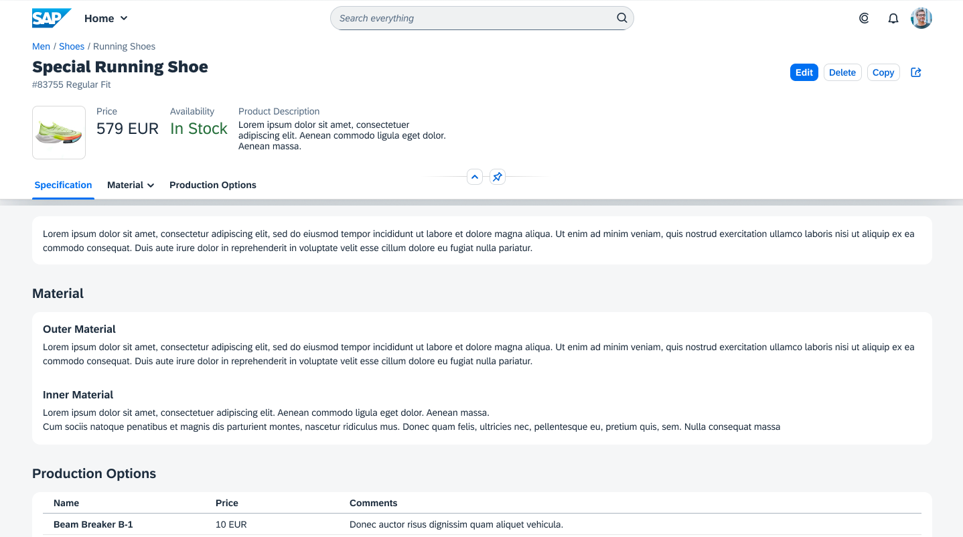
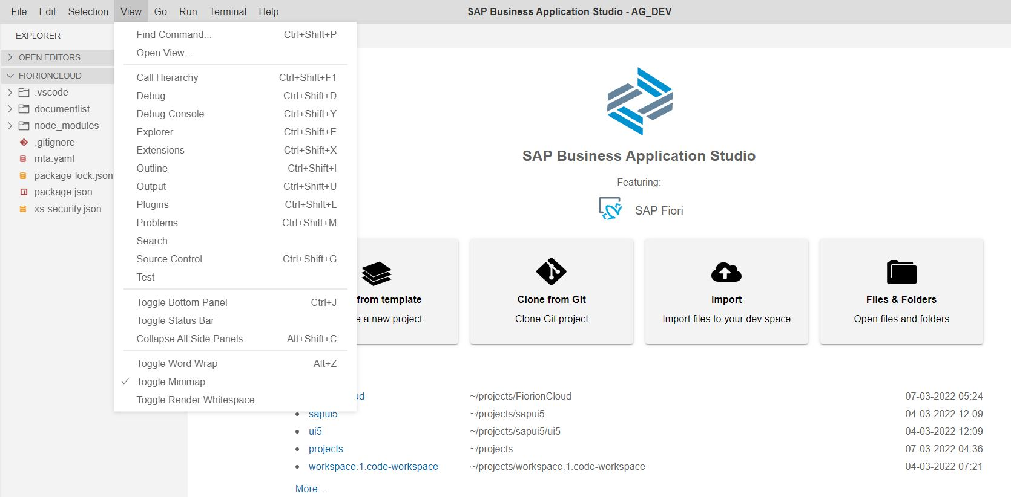
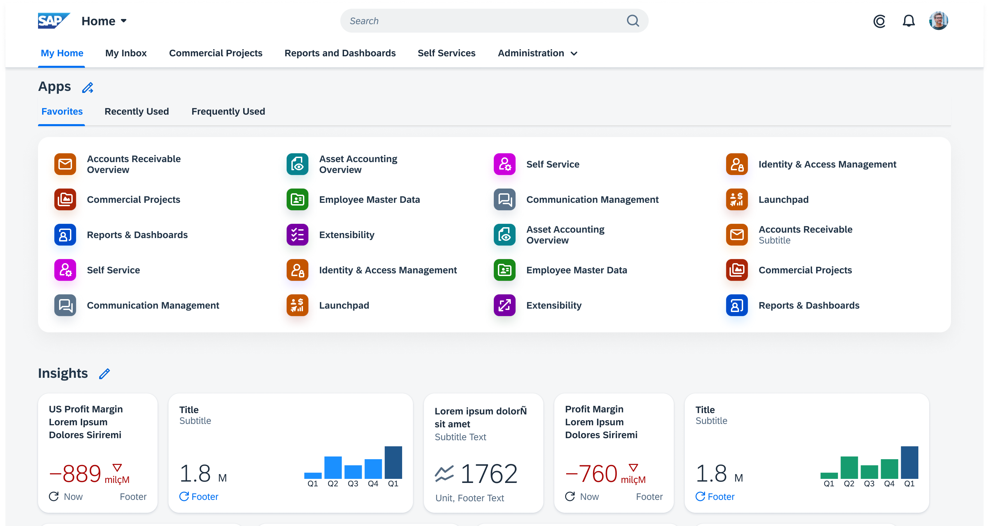
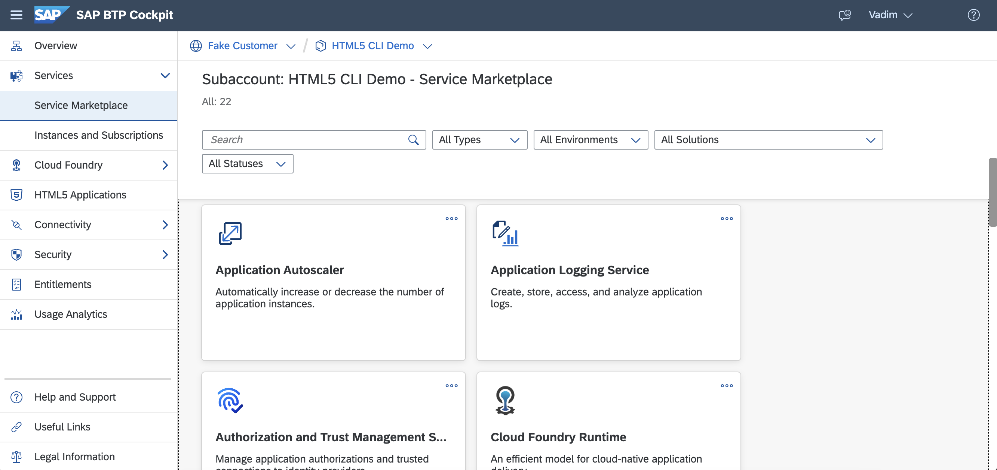
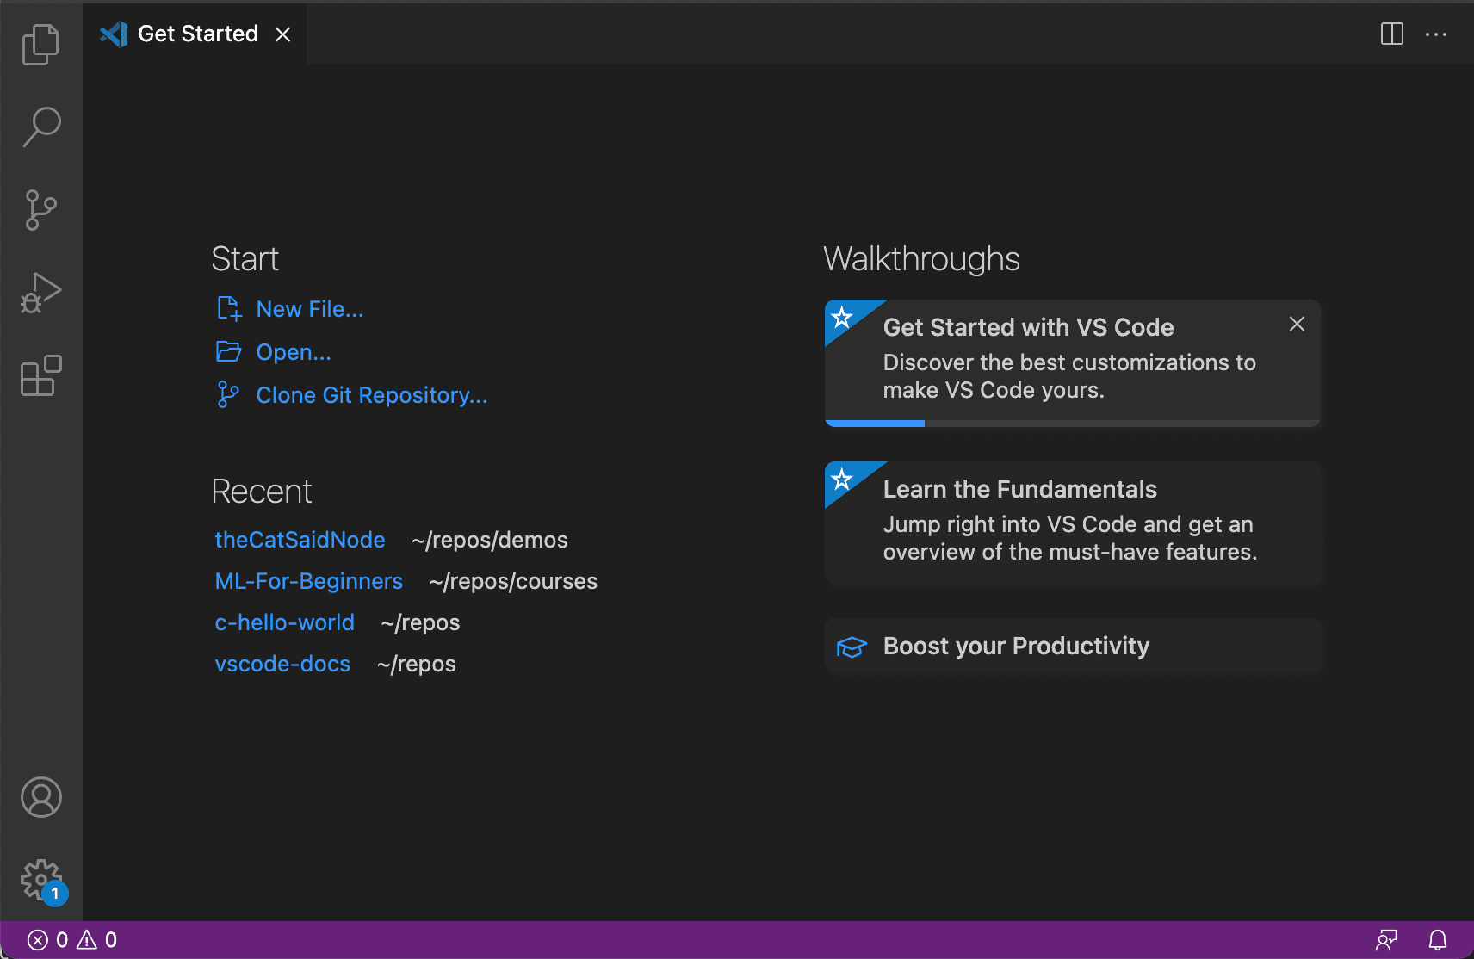
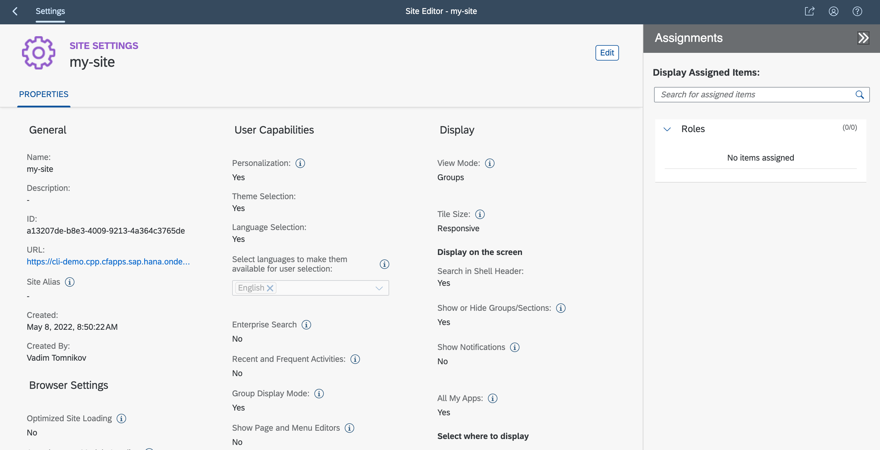
Front-end Applications Migration (Neo → CF)
BTP Neo Cockpit Services
WebIDE
API
CLI
Cockpit
Helium (Dispatcher)
https://account.hana.ondemand..
https://webidecp.dispatcher...
https://app.dispatcher...
Neo
Standalone App
Git
manifest.json
neo-app.json
mta.yaml
SAML, Roles
UI
Destinations
Cloud Portal
Web IDE
Helium Apps
Java Apps
AuthZ
BTP Multicloud Cockpit
Service Marketplace
BAS / VSCode / …
API
CLI
Cockpit
Launchpad / WorkZone
https://emea.cockpit.btp.cloud...
WorkZone / Managed AppRouter
CF
HTML5 app host
xs-security.json
manifest.json
xs-app.json
mta.yaml
OAuth, scopes
UI
https://acc1.cpp.cfapps.sap.hana..
Destinations
AuthZ
WorkZone
Business Application Studio
HTML5 Apps
CAP apps

Slide 36
High Level Migration Steps
The SAPUI5 application must be adopted to comply with the new BTP CF environment and the new development tools provided in Business Application Studio or VS Code.
These are the high level steps

Slide 37
Key Configuration Changes
 | Neo | Cloud Foundry
Hosting | Neo Git + Helium / Dispatcher | Own Git + HTML5 Repo + WorkZone
Runtime URLs | https://<appId>-<acId>.<HTML5NeoDomain>/index.html | https://<subdomain>.<wzdomain>/<sapCloudService>.<appId>/index.html
Routing | neo-app.json | xs-app.json
Destinations | HTML5 Application/Subaccount Level | Subaccount/Service Instance Level
Security | SAML, Roles + Client Side Permissions (neo-app.json) | OAuth, XSUAA scopes (xs-security.json) or IAS
Solutions (mta.yaml) | com.sap.hcp.html5 | com.sap.application.content

Slide 38
Appendix

Slide 39
Angular based HTML5 app migration
Fiori and UI5 Single Page Applications (SPAs) are using hash-based (aka fragment-based) navigation exclusively to switch between application views, meaning navigation is agnostic to URL path. But most modern UI frameworks, including Angular (React, Vue other examples) are using history-based (aka push-state) routing for navigation by default and are sensitive to the path structure, which may be incompatible with the one required by HTML5 Repo consumed via AppRouter in Cloud foundry.
It is possible to use arbitrary Angular apps with AppRouter and HTML5 Repo, but this may require custom development to change routing mechanism, which goes beyond capabilities of any migration tool.
Depending how Angular application routing was implemented in the application at the first place, the migration may be either smooth and easy or complicated.
In Summary :
In cloud foundry, from approuter/html5-repo perspective there is no limitation for using Angular. But SAP Workzone/FDC don’t support non Fiori projects.
html5-repo needs a manifest.json file with app.id/app.version, also for Angular projects
Avoid uploading Angular framework files into html5-repo → it might lead to exceeding the 100 MB per instance limitation. Such files should be retrieved from CDN (like it is done for sapui5 core files).

Slide 40
Forms by Adobe
Back to Analysis Slide

Slide 41
SAP Forms by Adobe Exporting the application from NEO
Recommendations​
The migration can be done by customers on their own without help from SAP, if they are on CPEA​
Introduction, Forms service by Adobe (Neo) here​
For CPEA customer: Enabling Forms service in (new) subaccount here ​
Changing connectivity URL in ABAP system here​
Changing settings in Cloud Connector here ​
Changing destination (ABAP, Cloud Connector) in BTP Subaccount here ​
Adsrestapi – connection set up at new account here ​
Adsrestapi – create oAuth client here ​
Downloading customer fonts and other ADS configuration from “old” account to “new” account here ​
Downloading/Uploading Form Templates store in the Forms service via REST API here ​
Downloading/Uploading Form Templates store in the Forms service via using the UI here ​

Slide 42
Connectivity Services
Back to Analysis Slide

Slide 43
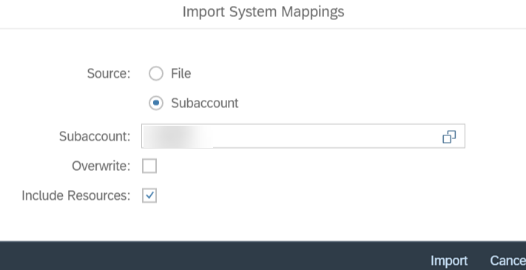
Configure SAP Cloud Connector
Configure SAP CF account into the relevant SAP cloud connector.
On the SAP cloud connector go to the Connector Tab.
Add the CPI CF sub account by filling out the required details.
In the subaccount choose the CPI CF account which is added in step 2 and press Connect button to establish a connection to the CPI CF. The SCC connection will now reflect in the CF CPI sub account which can be verified.
Now navigate to Cloud to on-premise button and under Access Control select Import System Mappings & select your SAP BTP Neo Sub account as the source to import the end points to CF account in SCC

Slide 44
Fiori Cloud
Back to Analysis Slide

Slide 45
Fiori Cloud – Central Launchpad Configuration Migration
Administrators have two options for integration of cloud and On-premise Fiori to Central Launchpad:
Manual integration of single applications using templates for common UI technologies such as SAPUI5, Web Dynpro ABAP or SAP GUI for HTML. Web applications can also be integrated using the generic (dynamic) URL launcher. You can configure applications to open in-place (with embedded UI using iFrames) or in new tab.
Advanced content federation: SAP products can serve as content providers by exposing selected business content including roles, applications, and related meta data. The data exchange is based on a Common Data Model (CDM) format, which is used to generically describe the content structure. Each provider system is responsible for exposing its content according to CDM
Check SAP Fiori Deployment Options and System Landscape Recommendations for further details on supported platforms and requisites.

Slide 46
Cloud Integration
Back to Analysis Slide

Slide 47







SAP Cloud Integration Migration strategy Side-by-side migration
SOLUTION
Provision a new SAP Integration Suite tenant
Migrate integration artifacts from source system to target system
Connect your consumers to target system
Neo environment
Multi cloud environment
Integration suite
1
2
Migrate
API Management
Cloud Integration
API Management
Cloud Integration
BENEFITS
Take advantage of a self-driven migration to upgrade your application in active use
Move your consuming applications in your phase
Minimize downtime for your consuming applications
Consumers
...
3

Slide 48
SAP Cloud Integration Migration Set up target environment
For migrating an existing CPI subscription that you have in the Neo environment to another CPI subscription in the public cloud infrastructures (hyperscalers) within the Multi-Cloud environment following steps to be followed:​
​Provision the CPI tenant in the Multi-Cloud environment by following the guide on help.sap.com or SCN Blog​
Optionally enable Enterprise messaging for JMS queue by following the help.sap.com​
Export & import the required destinations from SAP BTP Neo to SAP BTP Multi-Cloud sub account​
​Configure the SAP Cloud connector for the newly created SAP BTP Multi-Cloud sub account and import the exposed backend URLs from the SAP BTP Neo sub account into the SAP BTP Multi-Cloud sub account in SCC​
For configure only iflows from pre-packaged contents, custom iflows & Value mappings, number range objects use the migration pack to export & import, For modified pre-packaged contents manually export & import iflows from SAP BTP Neo to SAP BTP Multi-Cloud.​
Use the migration pack for copying the certificates from SAP BTP Neo to SAP BTP Multi-Cloud. Create User / OAuth / SFSF / Open Connectors Credentials in SAP BTP Multi-Cloud, manually import Key Pairs, Secure Parameters, PGP Public / Secret Keyrings, Known Hosts from your back up copy. ​
​Adjust the backends to the new CPI application SAP BTP Multi-Cloud sub account, perform end to end testing.​
Reconfigure the transport management service between the Dev/QA/PROD tenants.​

Slide 49
SAP Cloud Integration Migration ​ (Contd.) Activities for CPI migration​
Identify the iflows which will be migrated to the Multi-Cloud CPI subaccount. ​
Manual Activities for CPI migration​
Then on Multi-Cloud CPI application, manually configure the below security materials which are required for the iflow execution post migration.​
(i)User credential passwords (ii)Secure parameters (iii)Key pairs (iv)PGP keys (v) Trusted systems(known_hosts)​
Use of Migration pack for CPI​
Download Postman from https://postman.com​
Download CPI Migration Accelerator from SAP Note 2937549​
Based on your org decision execute the CPI migration pack for selectively migrating the CPI artifacts from SAP BTP Neo to SAP Multi-Cloud. The details of migration pack is available under the Migration Pack = Tooling and Documentation section in this report.​
Adjustments on consumer system​
In order to establish the connectivity between your Multi-Cloud CPI tenant and your consumer systems the backend systems needs adjustments in the configuration. You need to manually perform the steps required to establish a successful connection.​
In case, if you plan to use the Custom Domain on Multi-Cloud CPI tenant and retain the earlier domain names, then it may reduce certain manual steps for establishing the connectivity. Further details are available in the SAP Note :2937549 ​

Slide 50
SAP Cloud Integration Migration of Multi-Tier Landscapes How to migrate DEV/TEST/PROD tenants
Dev - Neo
Migration
Dev - CF
BEST PRACTICE
Pause integration flow development during migration to avoid double-maintenance
Dev-CF tenant: use migration accelerator to clone Dev-Neo
Test/Prod-CF: use standard transport from the previous CF tier use migration accelerator if necessary
Transport
Transport
Test - Neo
Test - CF
Transport
Transport
Prod - Neo
Prod - CF

Slide 51

SAP Cloud Integration Migration Accelerator Fast-track your move to multi-cloud
In scope for the accelerator
Integration content: pre-packaged and custom iflows / value mappings including configuration, custom tags
Security materials: public certificates, user credentials metadata, access policies
Runtime data: number ranges, local and global variables, data store
Out of scope for the accelerator*
Accelerator for migration of design-time artifact
Integration content: custom adapters
Sensitive security materials: passwords, key pairs, custom domain
Runtime data: monitoring data, JMS queues data, tenant sizing, message store, partner directory, historical version of the iflow/packages, principle propagation, platform and application user migration,
* User action required

Slide 52
SAP Cloud Integration Migration (Contd.) Additional Information
Email for questions regarding BTP migrations: sap.btp.migration@sap.com
BTP Migration Guides: https://help.sap.com/viewer/CP-Migration-Guide
List of restrictions in Cloud Foundry: SAP Note 2752867
SAP Cloud Platform Integration Suite Roadmap: link
How to setup a SAP CI tenant in Cloud Foundry: help.sap.com, Tutorial, blog
SAP CI Migration Tool : blog
SAP Integration Suite Free Tier Tenant blog #1 blog #2
Authentication and Authorization setup in Cloud Foundry:
Client Certificate Authentication setup: blog, link #1, link #2
Information about SAP CI roles in CF: link
Cloud Foundry data centers:
CF Data Centres and their IP addresses: link
Trusted CAs: link

Slide 53
Transport Management

Slide 54
Transport Management Service (Recommended) Overview
SAP Cloud Transport Management Service (TMS) manages application transport and content transport within a landscape on SAP BTP.
Completely cloud based.
Flexible tool to transport various types of content e.g. MTA, XS, .zip files.
This is subscription based so once entitlements are in place, this can be searched and subscribed.
The TMS is used by configuring:
Transport Destination: Used to address and manage destinations mapped in Multi-Cloud> Destinations
Transport Node: Represent endpoint on source/target, e.g. Multi-Cloud subaccount.
Transport Route: Used to connect transport nodes.
You then use the Import Queue which has the file to be transferred and can schedule the movement between transport nodes. For more information on this, please see this guide.

Slide 55
Subaccount Deletion

Slide 56

SAP BTP Capabilities – Deletion of Subaccount
Back to Next Steps Slide
Feature Set B – SAP Help
In the cockpit, go to the Account Explorer page of your global account.
In the account hierarchy, locate the subaccount that you want to delete.
In the Actions context menu of the subaccount, choose Delete.
Once you've a checked that it is safe to permanently remove the subaccount and its data, if such data exists, then you can approve the deletion operation in the Delete Subaccount with Content dialog box.
If the subaccount contains data, then you're also given the option to use the force-delete option, which deletes the subaccount and all its data for you.
NOTE: It is your responsibility to confirm that the subaccount is safe to delete before using the force-delete option. If you cannot check the content of the subaccount, you can get the subaccount reviewed by other qualified members of your organization.
Feature Set A - SAP Help
In the cockpit, navigate into the subaccount that you want to delete.
Choose Delete Subaccount and confirm the operation.
For more Information on Deletion of subaccount, follow the link here.
Removal of Custom domain.
Removal of subaccount by CLI.
Prerequisites (Feature Set B)
Global Account Administrator role
Any unused custom domain and corresponding SSL hosts and certificates must be removed
Prerequisites (Feature Set A)
Global Account Administrator role
Subaccount Security Administrator role
The subaccount doesn't contain any active subscriptions, service instances, brokers, or platforms
Any unused custom domain and corresponding SSL hosts and certificates must be removed
See also: 3305900 - Deleting Subaccount in BTP NEO Environment

Slide 57
Knowledge in Multi-Cloud

Slide 58

Knowledge in Multi-Cloud Environment
Before starting migration familiarize your developers with the multi-cloud environment and development concepts
Plan for a future-proof target account structure to avoid additional migration in future
Develop new functionality on Multi-Cloud Environment instead of Neo (best practice!)
Use migration packs along the journey
Resources
What Is the Multi-Cloud Foundation | SAP Help Portal
Cloud Foundry Environment | SAP Help Portal
Best Practices for SAP BTP | SAP Help Portal
Developing Full-Stack Applications Using SAP Business Application Studio | SAP Learning
Getting started with SAP Cloud Application Programming Model | SAP Learning
Introducing Cloud Security on SAP Business Technology Platform | SAP Learning
Building Side-by-Side Extensions on SAP BTP | SAP Learning
Delivering Side-by-Side Extensibility based on SAP BTP, Kyma runtime | SAP Learning
Discovering DevOps with SAP BTP | SAP Learning

Slide 59
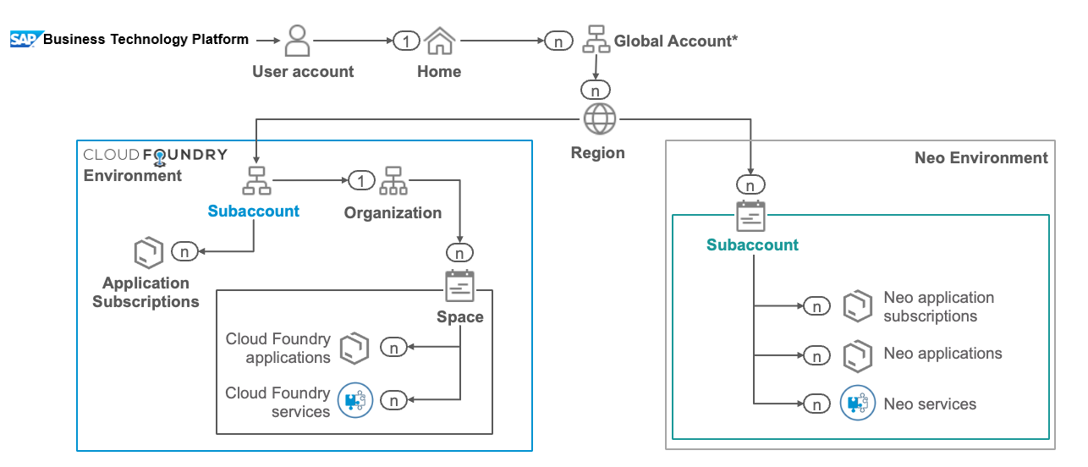
Account Structure
Account Structure between Neo and multi-cloud is different and consideration should be given to this when planning migration and target landscape setup
Accounts may be structured differently to incorporate the concept of spaces or introduce central/shared tenants for services such as integration suite.
Setting Up Your Account Model | SAP Help Portal

Slide 60
Migration Packs

Slide 61
What’s in a Migration Pack?
SAP will offer migration packs for
HANA, Portal, APIM, CPI, HTML 5 Apps, Mobile, Core capabilities (destinations, security, account model , …)
The Migration Handbook
The migration handbook has to describe precisely what the customer has to do in all 4 phases to migrate the respective service successfully. The Handbook will be kept up-to-date with the latest findings out of executed customer migrations.
How-to Guides, Best Practice Guides and FAQs
Every service will need specialized approaches dependent on the customer specific implementation. A continuously growing set of Assets is documenting and publishing this approaches to keep the discovery effort for the customer.
Migration Tooling
A set of documented scripts automating as many tasks as possible required to carry out the migration

Slide 62
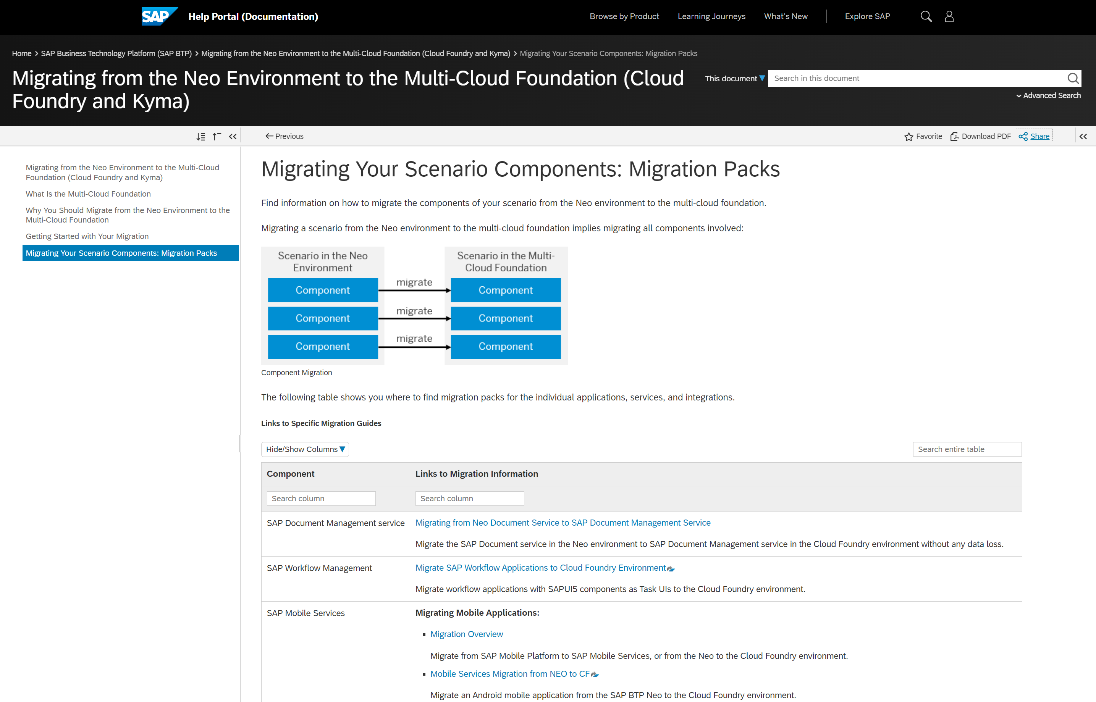
Neo Sunset program: Free migration assessment for SAP BTP customers Setting you on the right path to migrate your Neo implementation to a modern, multi-cloud foundation
Additional Information / Migration Packs:
Migration Packs

Slide 63
Service Specific Migration Packs
Service Component | Guide & Tools
SAP Cloud Integration | Available
API Management | Available
HTML5 Applications | Available
SAP Cloud Portal Service | Available
Mobile Services | Available
Data Quality Services | Available
SAP Document Management Service | Available
SAP Forms Service by Adobe | Available
SAP Open Connectors | Available
SAP Workflow Management | Available
SAP HANA Service | Available
Migration Packs

